Slide 1

























The name of the Family Tree,
last names, locations and other info
Sister
1900-1970.
Sister
1900-1970.
Sister
1900-1970.
Brother
1900-1970.
Brother
1900-1970.
Name of the person
1900-1970.
Brother
1900-1970.
Brother
1900-1970.
Additional info
Name of the person
19..-19...
Additional info
Name of the person
19..-19...
Additional info
Sister
1900-1970.
Sister
1900-1970.
Name of the person
19..-19...
Additional info
Name of the person
19..-19...
Additional info
Name of the person
19..-19...
Additional info
Name of the person
19..-19...
Additional info
.
Brother
1900-1970.
Sister
1900-1970.
Brother
1900-1970.
Name of the person
19..-19...
Additional info
Name of the person
19..-19...
Additional info
Name of the person
19..-19...
Additional info
Name of the person
19..-19...
Additional info
Name of the person
19..-19...
Additional info
Name of the person
19..-19...
Additional info
Name of the person
19..-19...
Additional info
Name of the person
19..-19...
Additional info
Name of the person
19..-19...
Additional info
Name of the person
19..-19...
Additional info
Name of the person
19..-19...
Additional info
Name of the person
19..-19...
Additional info
Name of the person
19..-19...
Additional info
Name of the person
19..-19...
Additional info
Name of the person
19..-19...
Additional info
Name of the person
19..-19...
Additional info
Name of the person
19..-19...
Additional info
Name of the person
19..-19...
Additional info
Name of the person
19..-19...
Additional info
Name of the person
19..-19...
Additional info
Name of the person
19..-19...
Additional info
Name of the person
19..-19...
Additional info
Name of the person
19..-19...
Additional info
Name of the person
19..-19...
Additional info
Name of the person
19..-19...
Additional info
Name of the person
19..-19...
Additional info
Name of the person
19..-19...
Additional info
Name of the person
19..-19...
Additional info
Name of the person 19..-..
Name of the person 19..-..
Name of the person 19..-..
Name of the person 19..-..
Name of the person 19..-..
Name of the person 19..-..
Name of the person 19..-..
Name of the person 19..-..
Name of the person 19..-..
Name of the person 19..-..
Name of the person 19..-..
Name of the person 19..-..
Name of the person 19..-..
Name of the person 19..-..
Name of the person 19..-..
Name of the person 19..-..
Name of the person
19..-19...
Additional info
Name of the person
19..-19...
Additional info
Name of the person
19..-19...
Additional info
Name of the person
19..-19...
Additional info
Name of the person
19..-19...
Additional info
Name of the person
19..-19...
Additional info
Name of the person
19..-19...
Additional info
Name of the person
19..-19...
Additional info
Name of the person
19..-19...
Additional info
Name of the person
19..-19...
Additional info
Name of the person
19..-19...
Additional info
Name of the person
19..-19...
Additional info
Name of the person
19..-19...
Additional info
Name of the person
19..-19...
Additional info
Name of the person
19..-19...
Additional info
Name of the person
19..-19...
Additional info
Name of the person 19..-..
Name of the person 19..-..
Name of the person 19..-..
Name of the person 19..-..
Name of the person 19..-..
Name of the person 19..-..
Name of the person 19..-..
Name of the person 19..-..
Name of the person 19..-..
Name of the person 19..-..
Name of the person 19..-..
Name of the person 19..-..
Name of the person 19..-..
Name of the person 19..-..
Name of the person 19..-..
Name of the person 19..-..
Name of the person 19..-..
Name of the person 19..-..
Name of the person 19..-..
Name of the person 19..-..
Name of the person 19..-..
Name of the person 19..-..
Name of the person 19..-..
Name of the person 19..-..
Name of the person 19..-..
Name of the person 19..-..
Name of the person 19..-..
Name of the person 19..-..
Name of the person 19..-..
Name of the person 19..-..
Name of the person 19..-..
Name of the person 19..-..
Name of the person
19..-19...
Additional info
Name of the person
19..-19...
Additional info
Name of the person
19..-19...
Additional info
Name of the person
19..-19...
Additional info
Name of the person
19..-19...
Additional info
Name of the person
19..-19...
Additional info
Name of the person
19..-19...
Additional info
Name of the person
19..-19...
Additional info
Name of the person
19..-19...
Additional info
Name of the person
19..-19...
Additional info
Name of the person
19..-19...
Additional info
Name of the person
19..-19...
Additional info
Name of the person 19..-..
Name of the person 19..-..
Name of the person 19..-..
Name of the person 19..-..
Name of the person 19..-..
Name of the person 19..-..
Name of the person 19..-..
Name of the person 19..-..
Name of the person 19..-..
Name of the person 19..-..
Name of the person 19..-..
Name of the person 19..-..
Name of the person 19..-..
Name of the person 19..-..
Name of the person 19..-..
Name of the person 19..-..

Slide 2
The name of the Family Tree,
last names, locations and other info
Sister
1900-1970.
Sister
1900-1970.
Sister
1900-1970.
Brother
1900-1970.
Brother
1900-1970.
Name of the person
1900-1970.
Brother
1900-1970.
Name of the person
19..-19...
Additional info
Name of the person
19..-19...
Additional info
Sister
1900-1970.
Sister
1900-1970.
Name of the person
19..-19...
Additional info
Name of the person
19..-19...
Additional info
Name of the person
19..-19...
Additional info
Name of the person
19..-19...
Additional info
.
Brother
1900-1970.
Sister
1900-1970.
Brother
1900-1970.
Name of the person
19..-19...
Additional info
Name of the person
19..-19...
Additional info
Name of the person
19..-19...
Additional info
Name of the person
19..-19...
Additional info
Name of the person
19..-19...
Additional info
Name of the person
19..-19...
Additional info
Name of the person
19..-19...
Additional info
Name of the person
19..-19...
Additional info
Name of the person
19..-19...
Additional info
Name of the person
19..-19...
Additional info
Name of the person
19..-19...
Additional info
Name of the person
19..-19...
Additional info
Name of the person
19..-19...
Additional info
Name of the person
19..-19...
Additional info
Name of the person
19..-19...
Additional info
Name of the person
19..-19...
Additional info
Name of the person
19..-19...
Additional info
Name of the person
19..-19...
Additional info
Name of the person
19..-19...
Additional info
Name of the person
19..-19...
Additional info
Name of the person
19..-19...
Additional info
Name of the person
19..-19...
Additional info
Name of the person
19..-19...
Additional info
Name of the person
19..-19...
Additional info
Name of the person
19..-19...
Additional info
Name of the person
19..-19...
Additional info
Name of the person
19..-19...
Additional info
Name of the person
19..-19...
Additional info
Name of the person 19..-..
Name of the person 19..-..
Name of the person 19..-..
Name of the person 19..-..
Name of the person 19..-..
Name of the person 19..-..
Name of the person 19..-..
Name of the person 19..-..
Name of the person 19..-..
Name of the person 19..-..
Name of the person 19..-..
Name of the person 19..-..
Name of the person 19..-..
Name of the person 19..-..
Name of the person 19..-..
Name of the person 19..-..
Name of the person
19..-19...
Additional info
Name of the person
19..-19...
Additional info
Name of the person
19..-19...
Additional info
Name of the person
19..-19...
Additional info
Name of the person
19..-19...
Additional info
Name of the person
19..-19...
Additional info
Name of the person
19..-19...
Additional info
Name of the person
19..-19...
Additional info
Name of the person
19..-19...
Additional info
Name of the person
19..-19...
Additional info
Name of the person
19..-19...
Additional info
Name of the person
19..-19...
Additional info
Name of the person
19..-19...
Additional info
Name of the person
19..-19...
Additional info
Name of the person
19..-19...
Additional info
Name of the person
19..-19...
Additional info
Name of the person 19..-..
Name of the person 19..-..
Name of the person 19..-..
Name of the person 19..-..
Name of the person 19..-..
Name of the person 19..-..
Name of the person 19..-..
Name of the person 19..-..
Name of the person 19..-..
Name of the person 19..-..
Name of the person 19..-..
Name of the person 19..-..
Name of the person 19..-..
Name of the person 19..-..
Name of the person 19..-..
Name of the person 19..-..
Name of the person 19..-..
Name of the person 19..-..
Name of the person 19..-..
Name of the person 19..-..
Name of the person 19..-..
Name of the person 19..-..
Name of the person 19..-..
Name of the person 19..-..
Name of the person 19..-..
Name of the person 19..-..
Name of the person 19..-..
Name of the person 19..-..
Name of the person 19..-..
Name of the person 19..-..
Name of the person 19..-..
Name of the person 19..-..
Name of the person
19..-19...
Additional info
Name of the person
19..-19...
Additional info
Name of the person
19..-19...
Additional info
Name of the person
19..-19...
Additional info
Name of the person
19..-19...
Additional info
Name of the person
19..-19...
Additional info
Name of the person
19..-19...
Additional info
Name of the person
19..-19...
Additional info
Name of the person
19..-19...
Additional info
Name of the person
19..-19...
Additional info
Name of the person
19..-19...
Additional info
Name of the person
19..-19...
Additional info
Name of the person 19..-..
Name of the person 19..-..
Name of the person 19..-..
Name of the person 19..-..
Name of the person 19..-..
Name of the person 19..-..
Name of the person 19..-..
Name of the person 19..-..
Name of the person 19..-..
Name of the person 19..-..
Name of the person 19..-..
Name of the person 19..-..
Name of the person 19..-..
Name of the person 19..-..
Name of the person 19..-..
Name of the person 19..-..

Slide 3
The name of the Family Tree,
last names, locations and other info
Sister
1900-1970.
Sister
1900-1970.
Sister
1900-1970.
Brother
1900-1970.
Brother
1900-1970.
Name of the person
1900-1970.
Brother
1900-1970.
Name of the person
19..-19...
Additional info
Name of the person
19..-19...
Additional info
Sister
1900-1970.
Sister
1900-1970.
Name of the person
19..-19...
Additional info
Name of the person
19..-19...
Additional info
Name of the person
19..-19...
Additional info
Name of the person
19..-19...
Additional info
.
Brother
1900-1970.
Sister
1900-1970.
Brother
1900-1970.
Name of the person
19..-19...
Additional info
Name of the person
19..-19...
Additional info
Name of the person
19..-19...
Additional info
Name of the person
19..-19...
Additional info
Name of the person
19..-19...
Additional info
Name of the person
19..-19...
Additional info
Name of the person
19..-19...
Additional info
Name of the person
19..-19...
Additional info
Name of the person
19..-19...
Additional info
Name of the person
19..-19...
Additional info
Name of the person
19..-19...
Additional info
Name of the person
19..-19...
Additional info
Name of the person
19..-19...
Additional info
Name of the person
19..-19...
Additional info
Name of the person
19..-19...
Additional info
Name of the person
19..-19...
Additional info
Name of the person
19..-19...
Additional info
Name of the person
19..-19...
Additional info
Name of the person
19..-19...
Additional info
Name of the person
19..-19...
Additional info
Name of the person
19..-19...
Additional info
Name of the person
19..-19...
Additional info
Name of the person
19..-19...
Additional info
Name of the person
19..-19...
Additional info
Name of the person
19..-19...
Additional info
Name of the person
19..-19...
Additional info
Name of the person
19..-19...
Additional info
Name of the person
19..-19...
Additional info
Name of the person 19..-..
Name of the person 19..-..
Name of the person 19..-..
Name of the person 19..-..
Name of the person 19..-..
Name of the person 19..-..
Name of the person 19..-..
Name of the person 19..-..
Name of the person 19..-..
Name of the person 19..-..
Name of the person 19..-..
Name of the person 19..-..
Name of the person 19..-..
Name of the person 19..-..
Name of the person 19..-..
Name of the person 19..-..
Name of the person
19..-19...
Additional info
Name of the person
19..-19...
Additional info
Name of the person
19..-19...
Additional info
Name of the person
19..-19...
Additional info
Name of the person
19..-19...
Additional info
Name of the person
19..-19...
Additional info
Name of the person
19..-19...
Additional info
Name of the person
19..-19...
Additional info
Name of the person
19..-19...
Additional info
Name of the person
19..-19...
Additional info
Name of the person
19..-19...
Additional info
Name of the person
19..-19...
Additional info
Name of the person
19..-19...
Additional info
Name of the person
19..-19...
Additional info
Name of the person
19..-19...
Additional info
Name of the person
19..-19...
Additional info
Name of the person 19..-..
Name of the person 19..-..
Name of the person 19..-..
Name of the person 19..-..
Name of the person 19..-..
Name of the person 19..-..
Name of the person 19..-..
Name of the person 19..-..
Name of the person 19..-..
Name of the person 19..-..
Name of the person 19..-..
Name of the person 19..-..
Name of the person 19..-..
Name of the person 19..-..
Name of the person 19..-..
Name of the person 19..-..
Name of the person 19..-..
Name of the person 19..-..
Name of the person 19..-..
Name of the person 19..-..
Name of the person 19..-..
Name of the person 19..-..
Name of the person 19..-..
Name of the person 19..-..
Name of the person 19..-..
Name of the person 19..-..
Name of the person 19..-..
Name of the person 19..-..
Name of the person 19..-..
Name of the person 19..-..
Name of the person 19..-..
Name of the person 19..-..
Name of the person
19..-19...
Additional info
Name of the person
19..-19...
Additional info
Name of the person
19..-19...
Additional info
Name of the person
19..-19...
Additional info
Name of the person
19..-19...
Additional info
Name of the person
19..-19...
Additional info
Name of the person
19..-19...
Additional info
Name of the person
19..-19...
Additional info
Name of the person
19..-19...
Additional info
Name of the person
19..-19...
Additional info
Name of the person
19..-19...
Additional info
Name of the person
19..-19...
Additional info
Name of the person 19..-..
Name of the person 19..-..
Name of the person 19..-..
Name of the person 19..-..
Name of the person 19..-..
Name of the person 19..-..
Name of the person 19..-..
Name of the person 19..-..
Name of the person 19..-..
Name of the person 19..-..
Name of the person 19..-..
Name of the person 19..-..
Name of the person 19..-..
Name of the person 19..-..
Name of the person 19..-..
Name of the person 19..-..

Slide 4
The name of the Family Tree,
last names, locations and other info
Sister
1900-1970.
Sister
1900-1970.
Sister
1900-1970.
Brother
1900-1970.
Brother
1900-1970.
Name of the person
1900-1970.
Brother
1900-1970.
Name of the person
19..-19...
Additional info
Name of the person
19..-19...
Additional info
Sister
1900-1970.
Sister
1900-1970.
Name of the person
19..-19...
Additional info
Name of the person
19..-19...
Additional info
Name of the person
19..-19...
Additional info
Name of the person
19..-19...
Additional info
.
Brother
1900-1970.
Sister
1900-1970.
Brother
1900-1970.
Name of the person
19..-19...
Additional info
Name of the person
19..-19...
Additional info
Name of the person
19..-19...
Additional info
Name of the person
19..-19...
Additional info
Name of the person
19..-19...
Additional info
Name of the person
19..-19...
Additional info
Name of the person
19..-19...
Additional info
Name of the person
19..-19...
Additional info
Name of the person
19..-19...
Additional info
Name of the person
19..-19...
Additional info
Name of the person
19..-19...
Additional info
Name of the person
19..-19...
Additional info
Name of the person
19..-19...
Additional info
Name of the person
19..-19...
Additional info
Name of the person
19..-19...
Additional info
Name of the person
19..-19...
Additional info
Name of the person
19..-19...
Additional info
Name of the person
19..-19...
Additional info
Name of the person
19..-19...
Additional info
Name of the person
19..-19...
Additional info
Name of the person
19..-19...
Additional info
Name of the person
19..-19...
Additional info
Name of the person
19..-19...
Additional info
Name of the person
19..-19...
Additional info
Name of the person
19..-19...
Additional info
Name of the person
19..-19...
Additional info
Name of the person
19..-19...
Additional info
Name of the person
19..-19...
Additional info
Name of the person 19..-..
Name of the person 19..-..
Name of the person 19..-..
Name of the person 19..-..
Name of the person 19..-..
Name of the person 19..-..
Name of the person 19..-..
Name of the person 19..-..
Name of the person 19..-..
Name of the person 19..-..
Name of the person 19..-..
Name of the person 19..-..
Name of the person 19..-..
Name of the person 19..-..
Name of the person 19..-..
Name of the person 19..-..
Name of the person
19..-19...
Additional info
Name of the person
19..-19...
Additional info
Name of the person
19..-19...
Additional info
Name of the person
19..-19...
Additional info
Name of the person
19..-19...
Additional info
Name of the person
19..-19...
Additional info
Name of the person
19..-19...
Additional info
Name of the person
19..-19...
Additional info
Name of the person
19..-19...
Additional info
Name of the person
19..-19...
Additional info
Name of the person
19..-19...
Additional info
Name of the person
19..-19...
Additional info
Name of the person
19..-19...
Additional info
Name of the person
19..-19...
Additional info
Name of the person
19..-19...
Additional info
Name of the person
19..-19...
Additional info
Name of the person 19..-..
Name of the person 19..-..
Name of the person 19..-..
Name of the person 19..-..
Name of the person 19..-..
Name of the person 19..-..
Name of the person 19..-..
Name of the person 19..-..
Name of the person 19..-..
Name of the person 19..-..
Name of the person 19..-..
Name of the person 19..-..
Name of the person 19..-..
Name of the person 19..-..
Name of the person 19..-..
Name of the person 19..-..
Name of the person 19..-..
Name of the person 19..-..
Name of the person 19..-..
Name of the person 19..-..
Name of the person 19..-..
Name of the person 19..-..
Name of the person 19..-..
Name of the person 19..-..
Name of the person 19..-..
Name of the person 19..-..
Name of the person 19..-..
Name of the person 19..-..
Name of the person 19..-..
Name of the person 19..-..
Name of the person 19..-..
Name of the person 19..-..
Name of the person
19..-19...
Additional info
Name of the person
19..-19...
Additional info
Name of the person
19..-19...
Additional info
Name of the person
19..-19...
Additional info
Name of the person
19..-19...
Additional info
Name of the person
19..-19...
Additional info
Name of the person
19..-19...
Additional info
Name of the person
19..-19...
Additional info
Name of the person
19..-19...
Additional info
Name of the person
19..-19...
Additional info
Name of the person
19..-19...
Additional info
Name of the person
19..-19...
Additional info
Name of the person 19..-..
Name of the person 19..-..
Name of the person 19..-..
Name of the person 19..-..
Name of the person 19..-..
Name of the person 19..-..
Name of the person 19..-..
Name of the person 19..-..
Name of the person 19..-..
Name of the person 19..-..
Name of the person 19..-..
Name of the person 19..-..
Name of the person 19..-..
Name of the person 19..-..
Name of the person 19..-..
Name of the person 19..-..

Slide 5
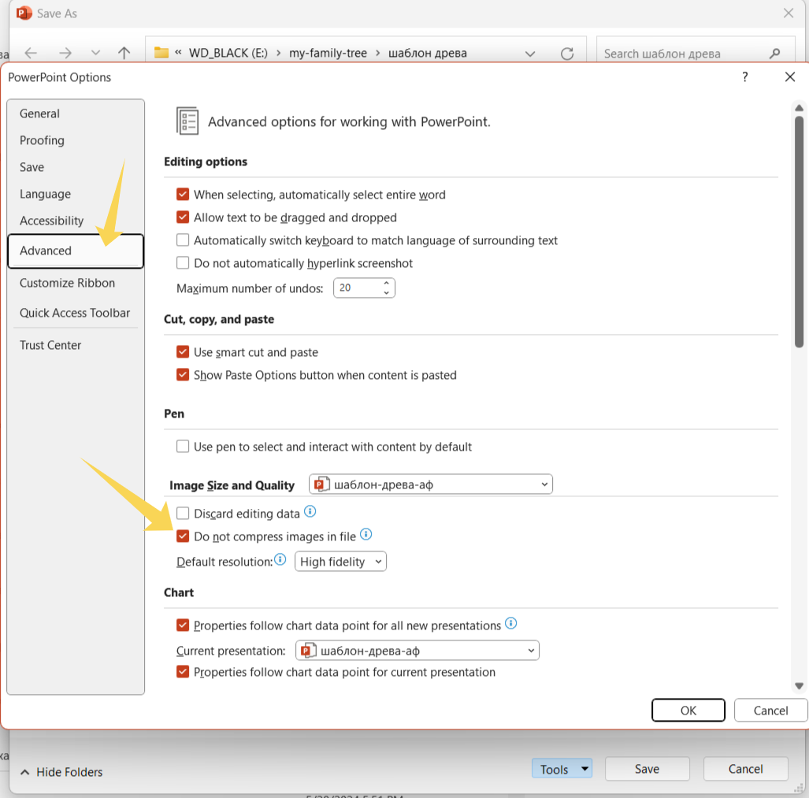
How to make changes to the template
This file contains 4 identical templates with slight differences in the background.
The font in the tree name is Nexa Script - https://font.download/font/nexa-script You can use any other.
The family tree may have different filling and structure, so the tree diagram is approximate. Elements can be moved, deleted, copied, resized.
Additional elements can be found in the last slide, they can be copied and pasted into the main tree.
You can immediately delete unnecessary slides, because the file is very heavy and can slow down the work a lot.
Photo placeholders can only be created and copied in the Slide Master setup mode. Therefore, at the bottom of the page there are additional ovals for photos that can be moved to the tree structure or deleted. To insert a photo, you just need to click on the oval.
To prevent elements such as arrows and banners from overlapping photos and text, you need to right-click and send the element to the back or, conversely, to the front.
The names of siblings of direct ancestors can be added as small ovals and placed around the name of the direct ancestor. The template contains examples of such arrangement.
The most difficult thing may be exporting the file to another format in high resolution for printing. Even if you choose the best quality in the export settings, the result may be mediocre (from personal experience). A rather tricky, but working method can be found here https://learn.microsoft.com/en-us/office/troubleshoot/powerpoint/change-export-slide-resolution
The standard way to save in the best of the default quality is as follows.Activate the side you want to save File > Save as > Save options > choose JEPG or PDF
The author- Alexandra Fomicheva (alfoart.com) alexandra.fomicheva@gmail.com You may delete my logo at the bottom of the page for the final product.
Feel free to contact me if you need a unique design for your family tree or custom changes. I can provide such services.

Slide 6

















Additional info

